Slide 1
Mini Project 1
Flight Price Predictor
By : Divendra Raj

Slide 2
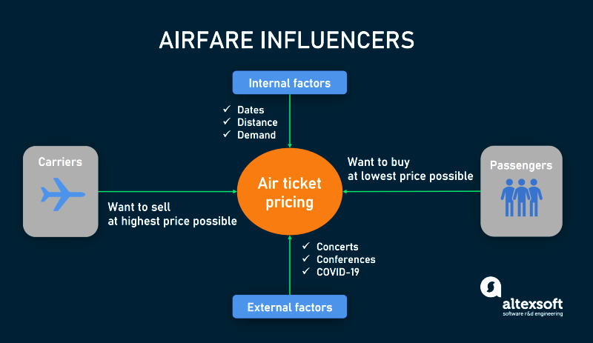
Business Context:
As you can see from the business prospective selling tickets at highest price as possible and passengers buying tickets at lowest price possible
There are some internal and external factors that affects the price when buying tickets

Slide 3
Business Question?
Does the features/factors really affect the ticket price or passenger pay price by journey?

Slide 4
Data Pipeline
Data
Importing
Cleaning
Understanding
Data Modelling
Data Visualisation
Testing and Results
Next Step
More Testing

Slide 5
Data Summary
- My data is India’s 2019 flight details csv file sourced from Kaggle project which has all the features discussed in context
  Different Airlines, Date of Journey, From and To, Total Stops, Departure and Arrival Times, Routes, Duration.
  Prices
Needed some data cleaning and engineering to the feature correlation
  Removing NA’s
  Converting data to integers
  Removing unique values
Feature of Interest
  Dep time
  Arrival time
  Duration
  Total stop

Slide 6
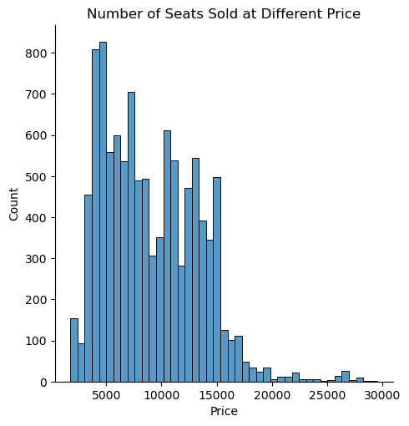
Exploratory Data Analysis
According to the data more people paid fares less 16000

Slide 7
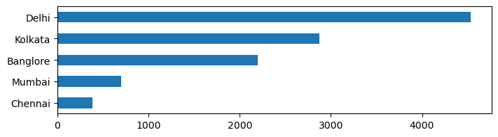
Exploratory Data Analysis
According to the data more people travelled out of Delhi than other cities
Number of Travellers by Different Cities
Number of Travellers

Slide 8
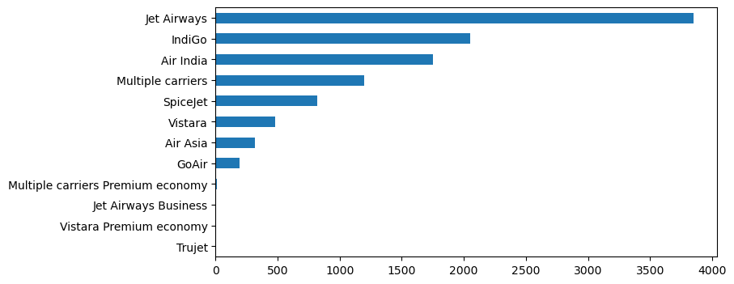
Exploratory Data Analysis
According to the data more people travelled Jet Airways other Airlines
Number of Travellers by Different Airlines
Number of Travellers

Slide 9
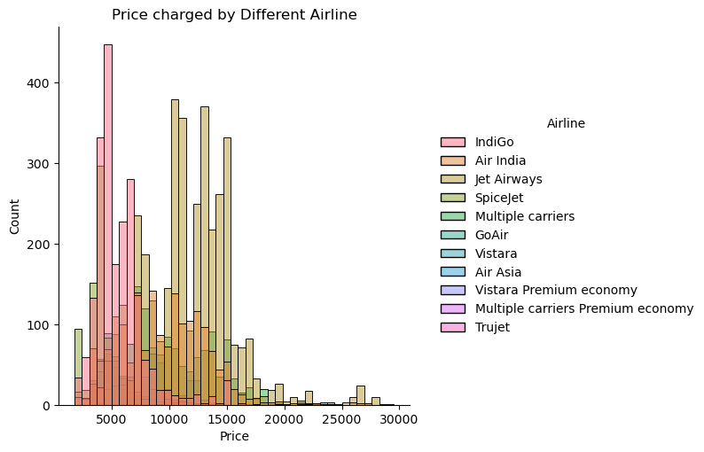
Exploratory Data Analysis
According to the data more people travelled Jet Airways other Airlines

Slide 10
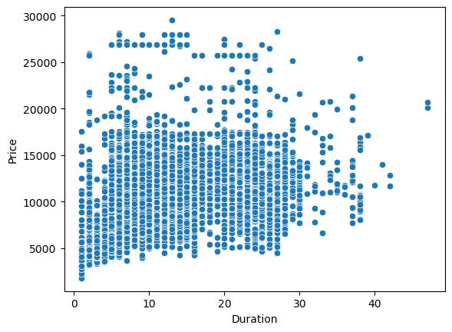
Data Visualisation
-People not only higher price for long distance but also for short distance travel
Scatter plot Price vs Duration

Slide 11
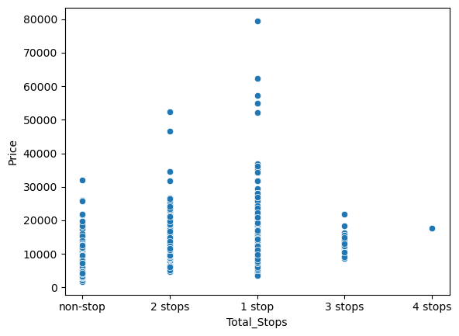
Scatterplot of 2 features : Price vs Total Stops
People turn to pay more price for 1 stop than more stops
Scatter plot for Price vs Total Stops

Slide 12
Hypothesis Testing
Hypothesis Question
  H0 – People pay high price for short journey
  H1 - Fare price increases for longer journeys
P-Value & T Test
  - Using the 2 sample got the results
  t = 3.55842549136334
  p = 0.0005770356912377275
- Outcome
  we rejected our null hypothesis and accepted alternative .
  Fare price increases for longer journeys.

Slide 13
Conclusion
- Summary
  - All the features has got effect on the price of the ticket.
Next steps
  There are also some other features that also determine the price like types of in house service, quality and frequency of service, destination and most important is the time when you buy the tickets.
  So the next step would be to gather more features and do further analysis.
  Thank You

